Slide 1
CH4203: Organic Synthesis Laboratory
----------------------------------------------------------------------------------------------
Expt. No. 9
Ugi Multicomponent Coupling for α-Amino Acid Derivatives

Slide 2
Green Chemistry
Green Chemistry is the design of chemical products and processes that reduce or eliminate the use and generation of hazardous substances.
12 Principles of Green Chemistry
1 | Prevention | It is better to prevent waste than to treat or clean up waste after it has been created.
2 | Atom Economy | Synthetic methods should be designed to maximize the incorporation of all materials used in the process into the final product.
3 | Less Hazardous Chemical Syntheses | Wherever practicable, synthetic methods should be designed to use and generate substances that possess little or no toxicity to human health and the environment.
4 | Designing Safer Chemicals | Chemical products should be designed to effect their desired function while minimizing their toxicity.
5 | Safer Solvents and Auxiliaries | The use of auxiliary substances (e.g., solvents, separation agents, etc.) should be made unnecessary wherever possible and innocuous when used.
6 | Design for Energy Efficiency | Energy requirements of chemical processes should be recognized for their environmental and economic impacts and should be minimized. If possible, synthetic methods should be conducted at ambient temperature and pressure.
Anastas, P. T. and Warner, J. C. Green Chemistry: Theory and Practice. Oxford University Press: New York, 1998, p. 30.

Slide 3
Green Chemistry
Green Chemistry is the design of chemical products and processes that reduce or eliminate the use and generation of hazardous substances.
12 Principles of Green Chemistry
7 | Use of Renewable Feedstocks | A raw material or feedstock should be renewable rather than depleting whenever technically and economically practicable.
8 | Reduce Derivatives | Unnecessary derivatization (use of blocking groups, protection/ deprotection, temporary modification of physical/chemical processes) should be minimized or avoided if possible, because such steps require additional reagents and can generate waste.
9 | Catalysis | Catalytic reagents (as selective as possible) are superior to stoichiometric reagents.
10 | Design for Degradation | Chemical products should be designed so that at the end of their function they break down into innocuous degradation products and do not persist in the environment.
11 | Real-time analysis for Pollution Prevention | Analytical methodologies need to be further developed to allow for real-time, in-process monitoring and control prior to the formation of hazardous substances.
12 | Inherently Safer Chemistry for Accident Prevention | Substances and the form of a substance used in a chemical process should be chosen to minimize the potential for chemical accidents, including releases, explosions, and fires.
Anastas, P. T. and Warner, J. C. Green Chemistry: Theory and Practice. Oxford University Press: New York, 1998, p. 30.

Slide 4
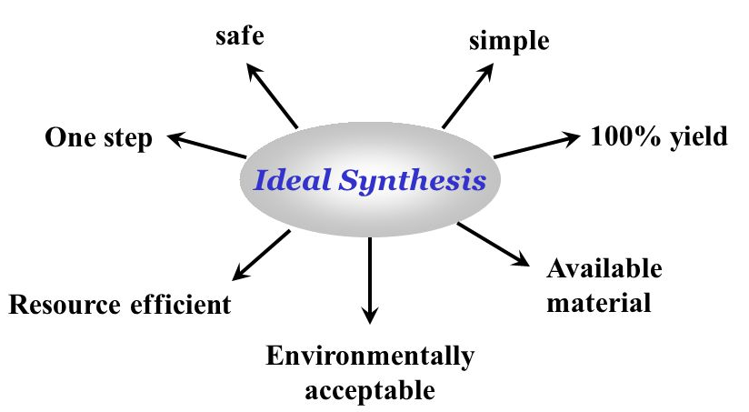
Ideal Synthesis
Robert W. Armstrong et al. Acc. Chem. Res. 1996, 29, 123; Alexander Dömling et. al. Angew. Chem. Int. Ed. 2000, 39, 3168

Slide 5
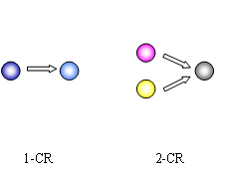
Multicomponent Reaction
Multicomponent reactions (MCRs) are convergent reactions, in which three or more starting materials react to form a product, where basically all or most of the atoms contribute to the newly formed product (remarkable atom economy), eventually in good to excellent chemical yields, while saving resources like time and energy.
In an MCR, a product is assembled according to a cascade of elementary chemical reactions. Thus, there is a network of reaction equilibria, which all finally flow into an irreversible step yielding the product. The challenge is to conduct an MCR in such a way that the network of pre-equilibrated reactions channel into the main product and do not yield side products.
The result is clearly dependent on the reaction conditions: solvent, temperature, catalyst, concentration, the kind of starting materials and functional groups. Such considerations are of particular importance in connection with the design and discovery of novel MCRs.
Robert W. Armstrong et al. Acc. Chem. Res. 1996, 29, 123; Alexander Dömling et. al. Angew. Chem. Int. Ed. 2000, 39, 3168

Slide 6
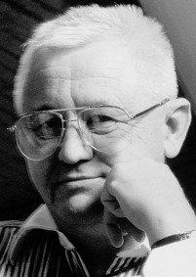

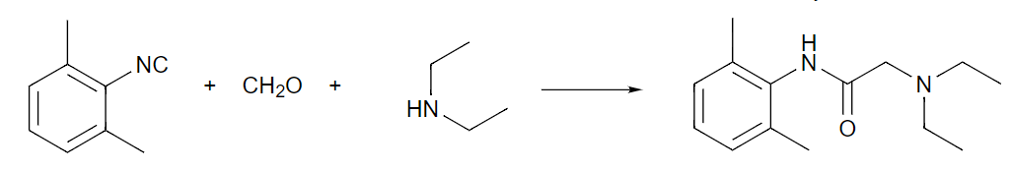
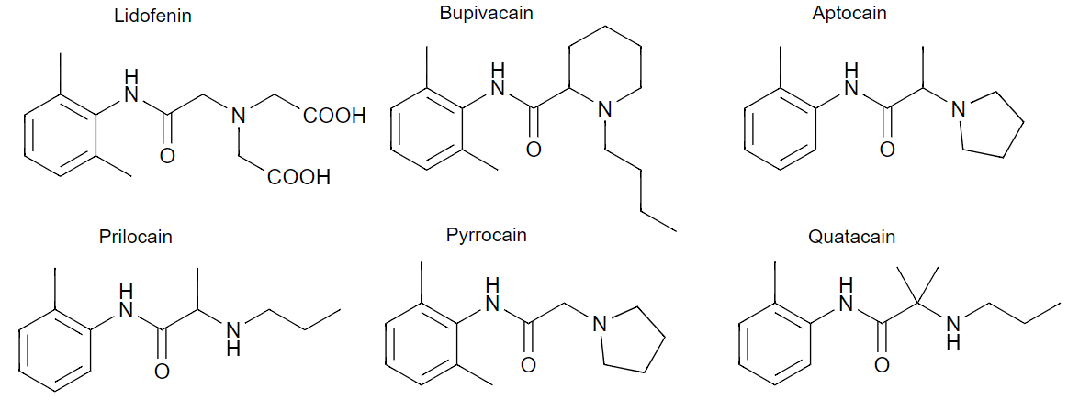
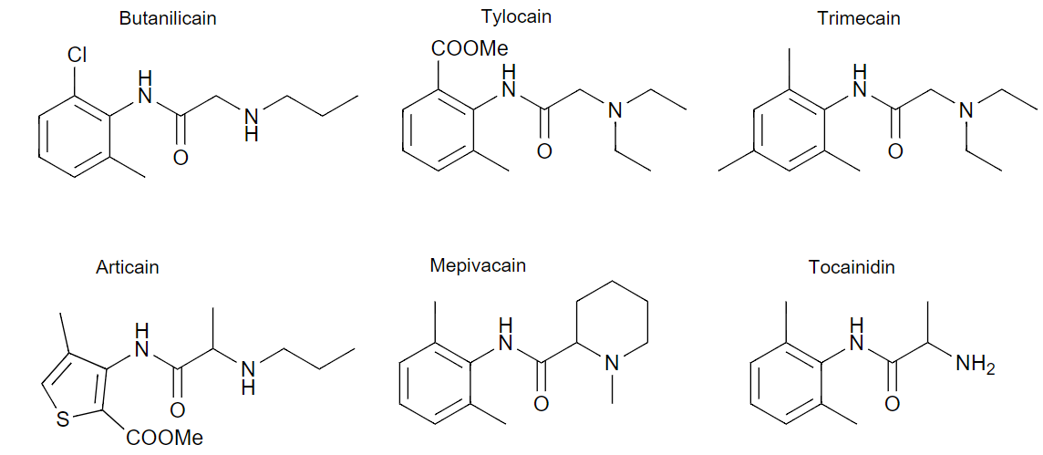
Ugi Reaction
The Ugi reaction (discovered in 1959) is a multi-component reaction in organic chemistry involving a ketone or aldehyde, an amine, an isocyanide and a carboxylic acid to form a bis-amide.
Ivar K. Ugi (1930–2005)
Highly versatile methods to make peptides and peptoids.
building up large compound libraries.
Xylocain, local anaesthetic
A.B. Astra, Swedish company
Alexander Dömling et. al. Angew. Chem. Int. Ed. 2000, 39, 3168

Slide 7
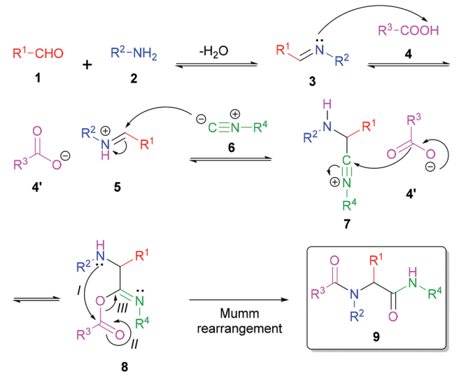
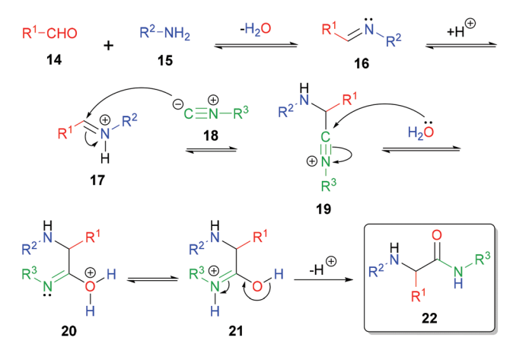
Ugi Reaction: Mechanism
Ugi Reaction: 4 component
Ugi Reaction: 3 component

Slide 8

Ugi Reaction
Generally Observed Properties of the Ugi Reaction
Rxn is exothermic and usually complete in minutes at room temperature
Aprotic, polar solvents are best, though the low molecular weight alcohols have been used
Can be performed in biphasic media
High (0.5-2M) reactant concentrations are best
By virtue of the mechanism, Lewis acids can accelerate the reaction
Precondensation of the amine and the carbonyl (preformation of the Schiff base) can increase yields.
Isocyanide
Only stable organic functionality with divalent carbon
Found in many natural products
Preparation: Dehydration of N-monosubstituted formamides with phosgene or derivatives thereof
Like carbenes, isocyanides can react with both necleophiles and electrophiles at the same carbon center

